Slide 1
Chapter 2: x86 Processor Architecture

Slide 2
Chapter Overview
General Concepts
IA-32 Processor Architecture
IA-32 Memory Management
Input-Output System

Slide 3
Structure - The CPU
CPU
Computer
Arithmetic
and
Login Unit
I/O
Registers
System
Bus
CPU
Internal CPU
Interconnection
Memory
Control
Unit

Slide 4
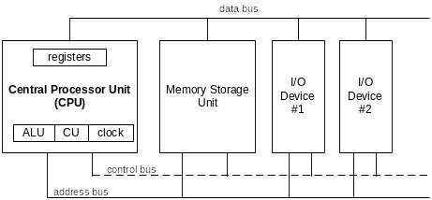
Basic Microcomputer Design
clock synchronizes CPU operations
control unit (CU) coordinates sequence of execution steps
ALU performs arithmetic and bitwise processing

Slide 5
What does the processor contain?
Busses - Carries data, control signals and
  addresses between the processor components and other devices within the computer.
Registers - High-speed memory units within the CPU.
Clock - synchronizes all the steps in fetching, decoding and executing instructions.

Slide 6
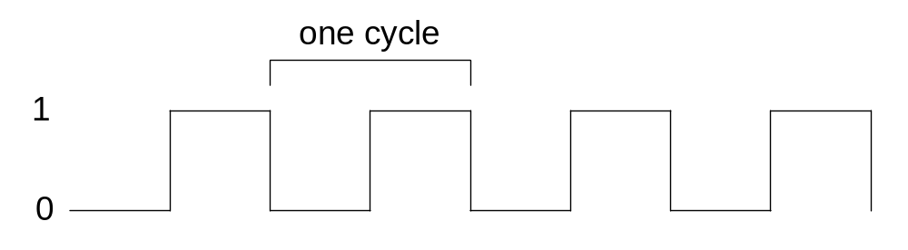
Clock
synchronizes all CPU and BUS operations
machine (clock) cycle measures time of a single operation
clock is used to trigger events

Slide 7
What's Next
General Concepts
IA-32 Processor Architecture
IA-32 Memory Management
Input-Output System

Slide 8
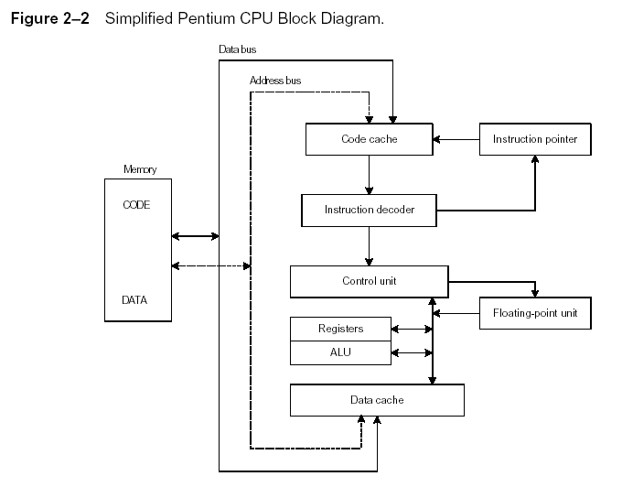
Instruction Execution Cycle
Fetch
Decode
Fetch operands
Execute
Store output

Slide 9
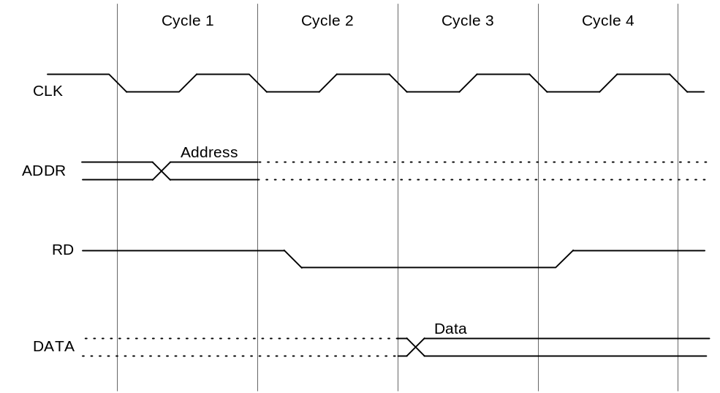
Reading from Memory
Multiple machine cycles are required when reading from memory, because it responds much more slowly than the CPU. The steps are:
  address placed on address bus
  Read Line (RD) set low
  CPU waits one cycle for memory to respond
  Read Line (RD) goes to 1, indicating that the data is on the data bus

Slide 10
Cache Memory
High-speed expensive static RAM both inside and outside the CPU.
  Level-1 cache: inside the CPU
  Level-2 cache: outside the CPU
Cache hit: when data to be read is already in cache memory
Cache miss: when data to be read is not in cache memory.

Slide 11
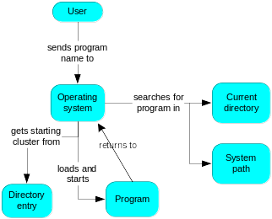
How a Program Runs

Slide 12
Multitasking
OS can run multiple programs at the same time.
Multiple threads of execution within the same program.
Scheduler utility assigns a given amount of CPU time to each running program.
Rapid switching of tasks
  gives illusion that all programs are running at once
  the processor must support task switching.

Slide 13
IA-32 Processor Architecture
Modes of operation
Basic execution environment
Floating-point unit
Intel Microprocessor history

Slide 14
Modes of Operation
Three primary modes of operations:
  Protected mode
    native mode (Windows, Linux)
    All instructions and features available
    Programs are given separate memory area (Segment), not reference memory outside their assigned segments.
  Real-address mode
    native MS-DOS
    Direct access to system memory and hardware devices
  System management mode
    power management, system security, diagnostics
    all normal execution (including the operating system) is suspended, and special separate software (usually firmware or a hardware-assisted debugger) is executed in high-privilege mode

Slide 15
Basic Execution Environment
Addressable memory
General-purpose registers
Index and base registers
Specialized register uses
Status flags
Floating-point, MMX, XMM registers

Slide 16
Addressable Memory
In protected mode IA-32 processors can access up to 4 Gigabytes of storage, with memory addresses from 0 to 2³²-1.
In real mode, a maximum of 1 megabyte of memory can be accessed with memory addresses from 0 to 2²⁰-1.
The IA-32 processors provide a Virtual 8086 where multiple MS-DOS programs can run safely within an Windows environment.

Slide 17

General-Purpose Registers
Named storage locations inside the CPU, optimized for speed.
Primarily used for arithmetic and data movement
Processor status flags register
Instruction pointer register

Slide 18


Accessing Parts of Registers
Use 8-bit name, 16-bit name, or 32-bit name
Applies to EAX, EBX, ECX, and EDX

Slide 19

Index and Base Registers
Some registers have only a 16-bit name for their lower half:

Slide 20
Some Specialized Register Uses
General-Purpose
  EAX – accumulator
  ECX – loop counter
  ESP – stack pointer
  ESI, EDI – source/destination index registers
  EBP – extended frame pointer (reference function parameter and local variable on stack)
Segment: indicate the base addresses
  CS – code segment
  DS – data segment
  SS – stack segment
  ES, FS, GS - additional segments

Slide 21
Some Specialized Register Uses
EIP – instruction pointer (contain the address of next instruction to be executed)
EFLAGS
  status and control flags: control the operation of CPU or reflect the outcome of some CPU operations
  each flag is a single binary bit
  Program can set individual bits in EFLAGS register

Slide 22
Status Flags
Carry (CF)
  unsigned arithmetic out of range
Overflow (OF)
  signed arithmetic out of range
Sign (SF)
  (arithmetic or logical operations) result is negative
Zero (ZF)
  result is zero
31 | 30 | 29 | 28 | 27 | 26 | 25 | 24 | 23 | 22 | 21 | 20 | 19 | 18 | 17 | 16
0 | 0 | 0 | 0 | 0 | 0 | 0 | 0 | 0 | 0 | ID | VIP | VIF | AC | VM | RF
15 | 14 | 13 | 12 | 11 | 10 | 9 | 8 | 7 | 6 | 5 | 4 | 3 | 2 | 1 | 0
0 | NT | IOPL |  | OF | DF | IF | TF | SF | ZF | 0 | AF | 0 | PF | 1 | CF

Slide 23

Floating-Point, MMX, XMM Registers
Eight 80-bit floating-point data registers
  ST(0), ST(1), . . . , ST(7)
  arranged in a stack
  used for all floating-point arithmetic
Eight 128-bit XMM registers support special instruction single-instruction multiple-data (SIMD) operations

Slide 24
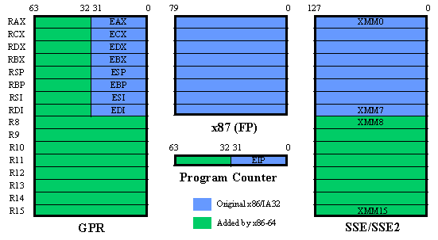
64-bit vs. 32-bit

Slide 25
Early Intel Microprocessors
Intel 8080
  64K addressable RAM
  8-bit registers
  CP/M operating system
  S-100 BUS architecture
  8-inch floppy disks!
Intel 8086/8088
  IBM-PC Used 8088
  1 MB addressable RAM
  16-bit registers
  16-bit data bus (8-bit for 8088)
  separate floating-point unit (8087)

Slide 26
The IBM-AT
Intel 80286
  16 MB addressable RAM
  Protected memory
  several times faster than 8086
  introduced IDE bus architecture
  80287 floating point unit

Slide 27
Intel IA-32 Family
Intel386
  4 GB addressable RAM, 32-bit registers, paging (virtual memory)
Intel486
  instruction pipelining
    The instruction set was implemented with up to 5 instructions fetched and decoded at once
Pentium
  superscalar, 32-bit address bus, 64-bit internal data path
  decode and executed two instructions at the same time, using dual pipelining

Slide 28
64-bit Processors
Intel64
  64-bit linear address space
  Intel: Pentium Extreme, Xeon, Celeron D, Pendium D, Core 2, and Core i7
IA-32e Mode
  Compatibility mode for legacy 16- and 32-bit applications
  64-bit Mode uses 64-bit addresses and operands

Slide 29
Intel Processor Families
Currently Used:
Pentium & Celeron – dual core
Core 2 Duo - 2 processor cores
Core 2 Quad - 4 processor cores
Core i7 – 4 processor cores

Slide 30
CISC and RISC
CISC – complex instruction set
  large instruction set: execute several low-level operations, such as a load from memory, an arithmetic operation, and a memory store
  high-level operations
  requires microcode interpreter
  examples: Intel 80x86 family
RISC – reduced instruction set
  simple, atomic instructions
  small instruction set
  directly executed by hardware
  examples:
    ARM (Advanced RISC Machines, 32-bit RISC)
    DEC Alpha (now Compaq, 64-bit RISC)

Slide 31
What's Next
General Concepts
IA-32 Processor Architecture
IA-32 Memory Management
Input-Output System

Slide 32
IA-32 Memory Management
Real-address mode
Calculating linear addresses
Protected mode
Multi-segment model
Paging

Slide 33
Real-Address mode
1 MB RAM maximum addressable, from 00000 to FFFFF
Application programs can access any area of memory
Single tasking: one program at a time
Supported by MS-DOS operating system (windows 95/98 can boot in this mode)

Slide 34

Segmented Memory
Segmented memory addressing: absolute (linear) address is a combination of a 16-bit segment value added to a 16-bit offset
one segment
linear addresses
the 16-bit segment selector was interpreted as the most significant 16 bits of a linear 20-bit address, with the remaining four bits being all zeros

Slide 35
Calculating Linear Addresses
Given a segment address, multiply it by 16 (add a hexadecimal zero), and add it to the offset
Example: convert 08F1:0100 to a linear address
Adjusted Segment value: 0 8 F 1 0
Add the offset: 0 1 0 0
Linear address: 0 9 0 1 0

Slide 36
Your turn . . .
What linear address corresponds to the segment/offset address 028F:0030?
028F0 + 0030 = 02920
Always use hexadecimal notation for addresses.

Slide 37
Your turn . . .
What segment addresses correspond to the linear address 28F30h?
Many different segment-offset addresses can produce the linear address 28F30h. For example:
28F0:0030, 28F3:0000, 28B0:0430, . . .

Slide 38
Protected Mode
4 GB addressable RAM
  (00000000 to FFFFFFFFh)
Each program assigned a memory partition which is protected from other programs
Designed for multitasking
Supported by Linux & MS-Windows

Slide 39
Protected mode (cont’d)
Segment descriptor tables
  OS uses to keep track of locations of individual programs
Program structure
  code, data, and stack areas
  CS, DS, SS segment descriptors
  global descriptor table (GDT)
MASM Programs use the Microsoft flat memory model
linear memory model

Slide 40
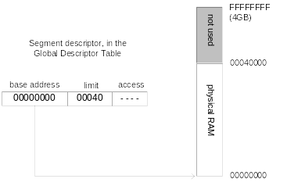
Flat Segment Model
Single global descriptor table (GDT).
All segments mapped to entire 32-bit address space
Irvine, Kip R. Assembly Language for x86 Processors 6/e, 2010.

Slide 41
Multi-Segment Model
Each program has a local descriptor table (LDT)
  holds descriptor for each segment used by the program

Slide 42
Paging
Supported directly by the CPU (IA-32)
Divides each segment into 4096-byte blocks (4K units) called pages
Many of these pages of memory are saved on disk in a swap file and are loaded into memory when the CPU needs a page that is not present in physical memory. This situation is called a page fault.
The use of paging and swap files allows the memory used to be several times larger than physical memory; it is known as virtual memory.
Virtual memory manager (VMM) – OS utility that manages the loading and unloading of pages
Page fault – issued by CPU when a page must be loaded from disk

Slide 43
Components of an IA-32 Microcomputer
Motherboard
Video output
Memory
Input-output ports

Slide 44
Motherboard
CPU socket
External cache memory slots
Main memory slots
BIOS chips
Sound synthesizer chip (optional)
Video controller chip (optional)
IDE, parallel, serial, USB, video, keyboard, joystick, network, and mouse connectors
PCI bus connectors (expansion cards)

Slide 45
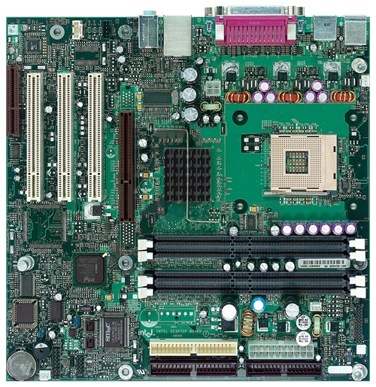
Intel D850MD Motherboard
Video
mouse, keyboard, parallel, serial, and USB connectors
Audio chip
PCI slots
memory controller hub
Pentium 4 socket
AGP slot
dynamic RAM
Firmware hub
I/O Controller
Speaker
Power connector
Battery
Diskette connector
Source: Intel® Desktop Board D850MD/D850MV Technical Product Specification
IDE drive connectors

Slide 46
What's Next
General Concepts
IA-32 Processor Architecture
IA-32 Memory Management
Input-Output System

Slide 47
Levels of Input-Output
Level 3: High-level language function
  examples: C++, Java contain functions to perform IO
  These functions are portable, convenient, not always the fastest
Level 2: Operating system
  Call OS function from library, i.e. Application Programming Interface (API)
  extended capabilities, lots of details to master
Level 1: BIOS (basic IO system)
  drivers (low-level subroutine) that communicate directly with devices
  OS security may prevent application-level code from working at this level

Slide 48
Displaying a String of Characters
When a HLL program displays a string of characters, the following steps take place:
HLL program call HLL library function on writing string to standard output
Library function calls OS function
OS function uses a loop to call a BIOS subroutine
BIOS subroutine receives a character and send it to hardware
Video controller card generates signals to the video display

Slide 49
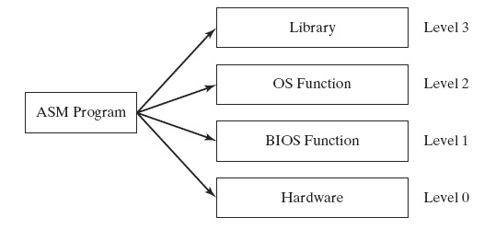
Programming levels
Assembly language programs can perform input-output at each of the following levels:
Call library function
call OS function
Call BIOS subroutine
Send and receive data from hardware ports, control specific devices

